Slide 1
Viral phylodynamic applications to vaccine prediction
Aubry Landsom

Slide 2
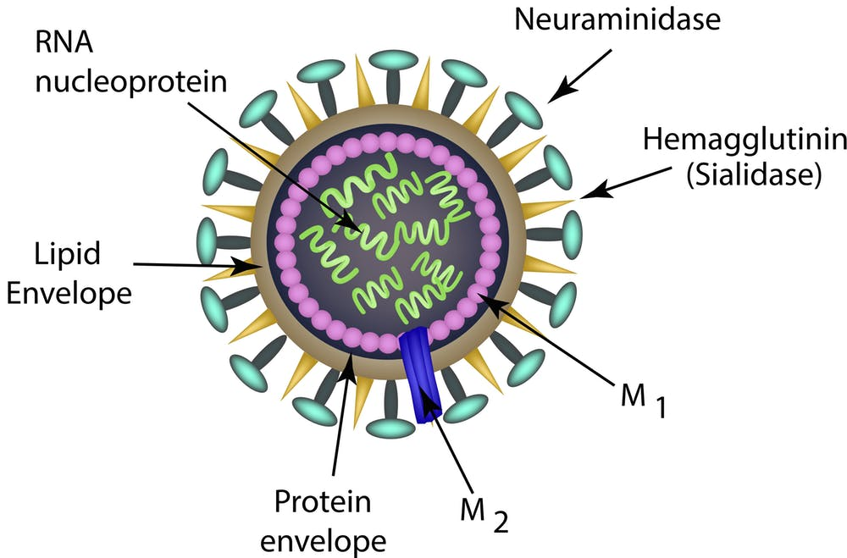
Influenza Introduction
RNA virus
Hemagglutinin: attachment and entry
Neuraminidase: virion release
Segmented genome

Slide 3
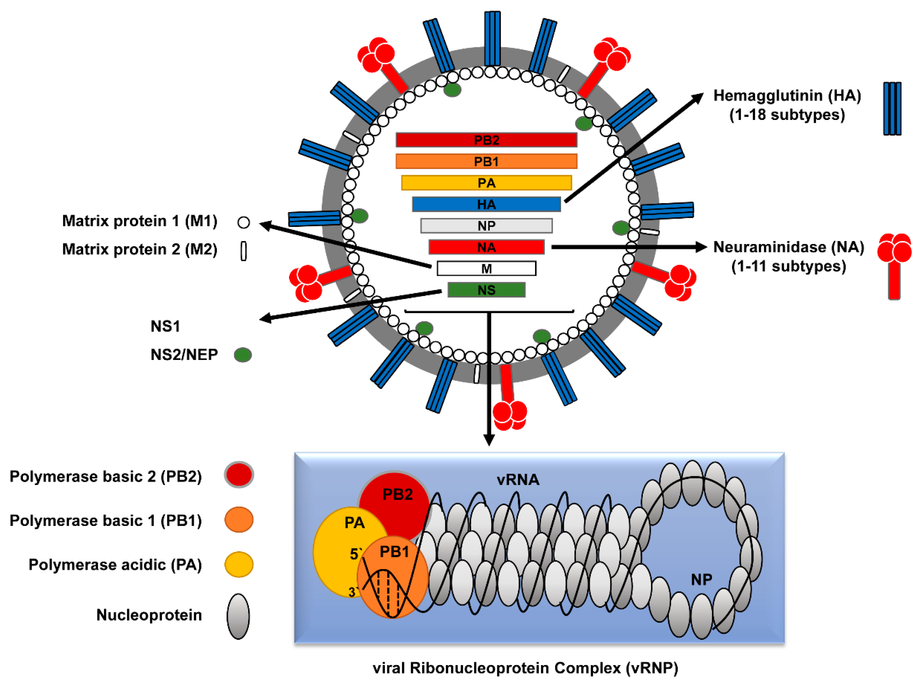
Influenza Introduction
RNA virus
Hemagglutinin: attachment and entry
Neuraminidase: virion release
Segmented genome

Slide 4
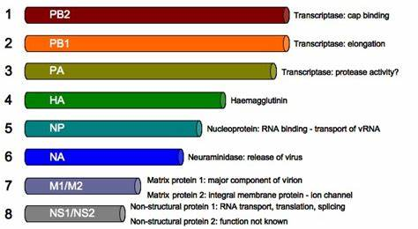
Influenza Introduction
RNA virus
Hemagglutinin: attachment and entry
Neuraminidase: virion release
Segmented genome

Slide 5
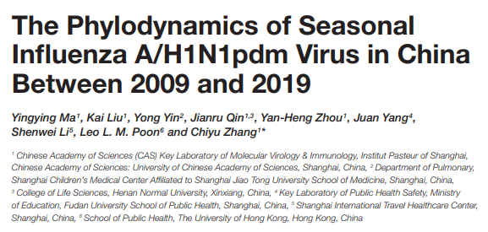
Influenza Phylogenetics

Slide 6
Overview
Purpose: characterize recent strain to determine reason for increase in cases
Data analyzed: 335 complete genome,1259 HA, and 1043 NA
Methods:
Non-synonymous and synonymous substitution rate showed selection for specific traits
Mixed Effects Model of Evolution (MEME) and Bayesian Experience Bayesian (BEB) methods inferred positively selected sites
Maximum Clade Credibility (MCM) trees illustrated the evolution of eight segments of the genome
The selection pressure variation was also graphed
A map of China represented the estimated migration history of the virus

Slide 7
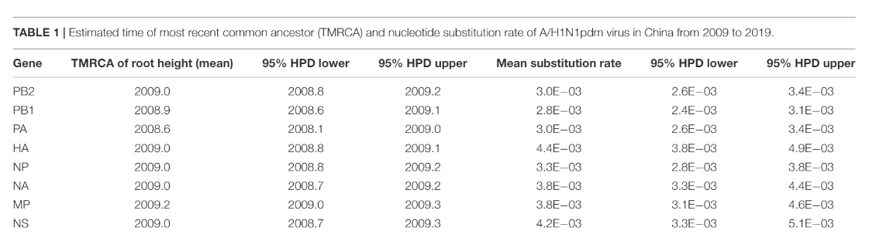

Slide 8
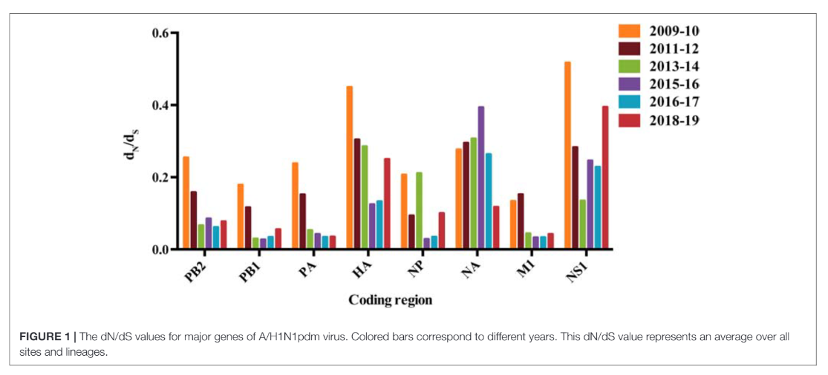

Slide 9
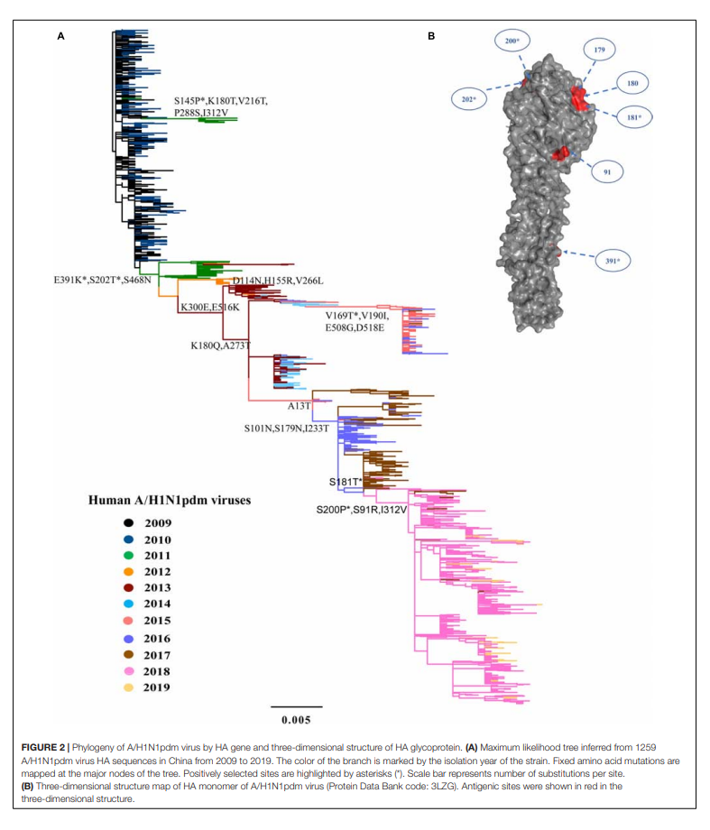

Slide 10
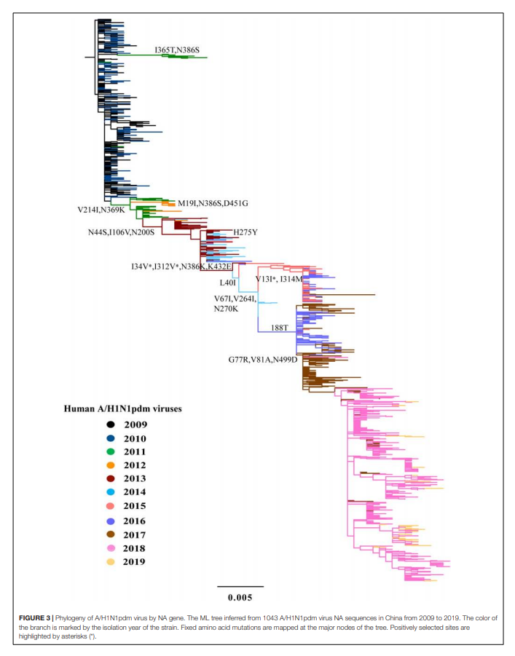

Slide 11
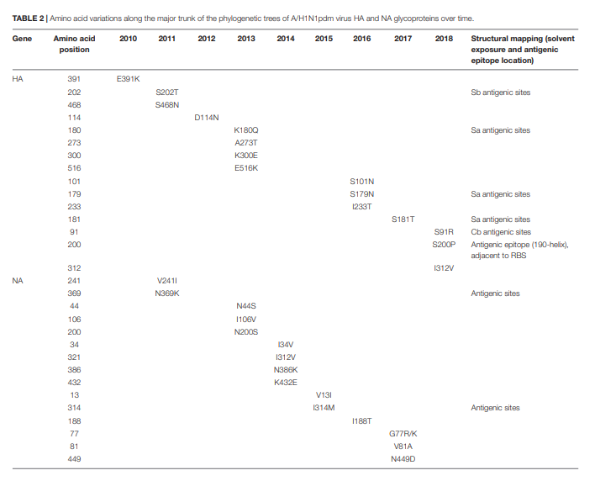

Slide 12
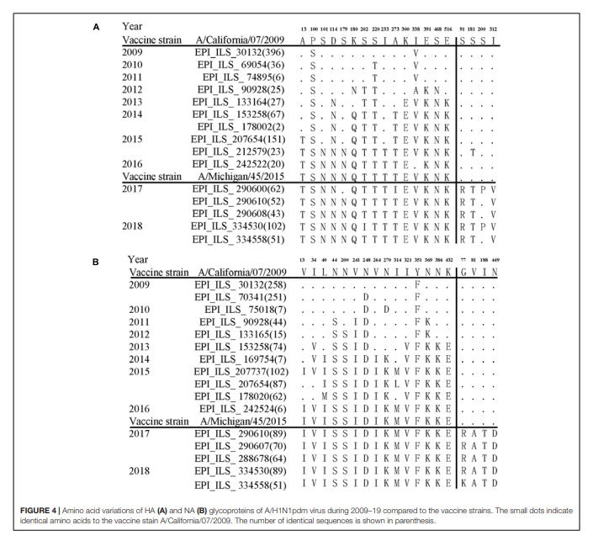

Slide 13
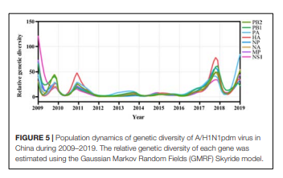

Slide 14
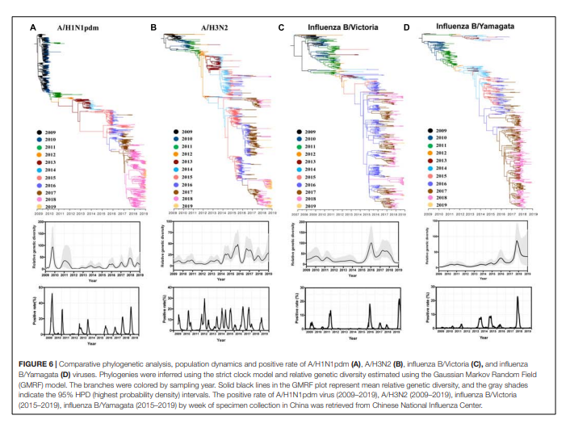

Slide 15
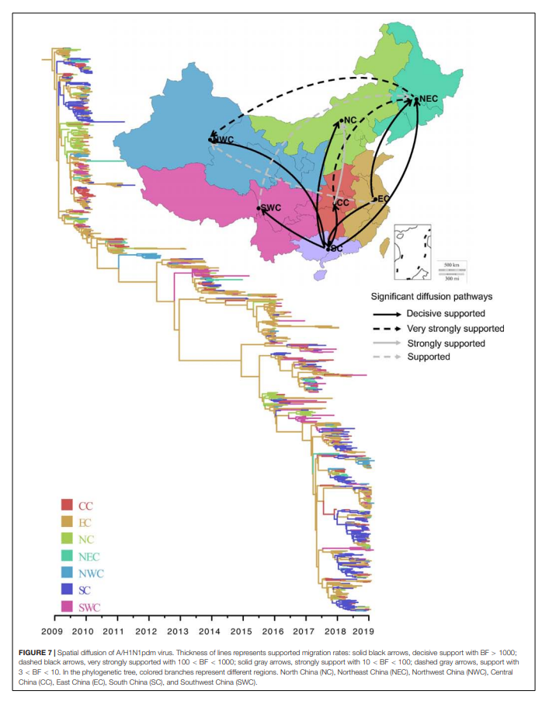

Slide 16
Findings
dN/dS value and relative genetic diversity decreased from 2009-2017 and increased from 2018-2019
Other influenza strains also show an increase from 2018-2019
15 amino acid changes were fixed on both the HA and NA tree
East China and South China acted at the major epicenters for the virus

Slide 17
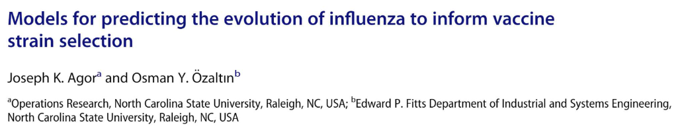
Influenza Vaccine Prediction

Slide 18
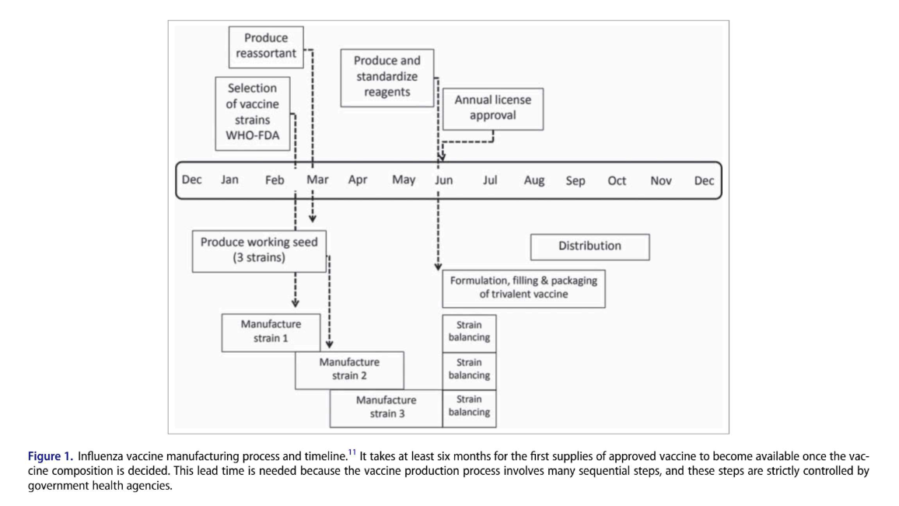

Slide 19
Overview
Current methods include surveillance of emerging viruses and using animal models
It is difficult to predict antigenic drift
It is difficult to predict the fate of viral strains
nextflu analyzes circulation patterns to provide predictions
It is currently tracking A/H3N2, A/H1N1pdm, B/Victoria, and B/Yamagata
It infers internal nodes using marginal maximum likelihood method
It estimates frequency trajectories of mutation, genotypes, and clades

Slide 20
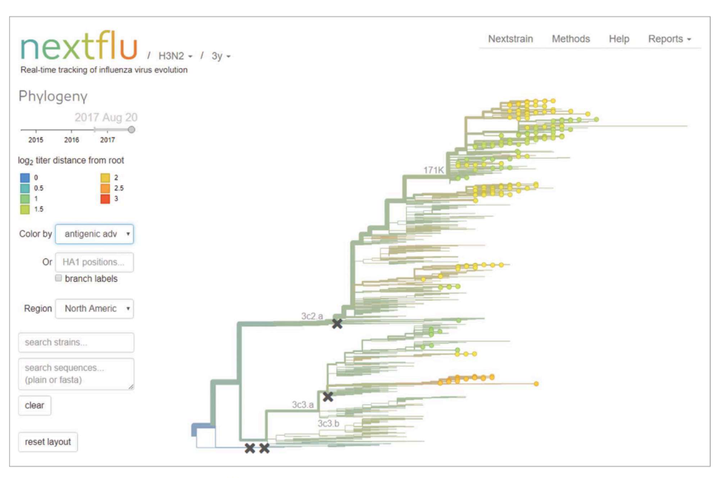

Slide 21
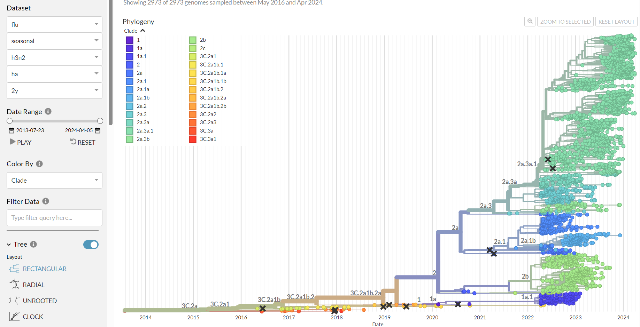
Nextstrain / flu / seasonal / h3n2 / ha / 2y

Slide 22
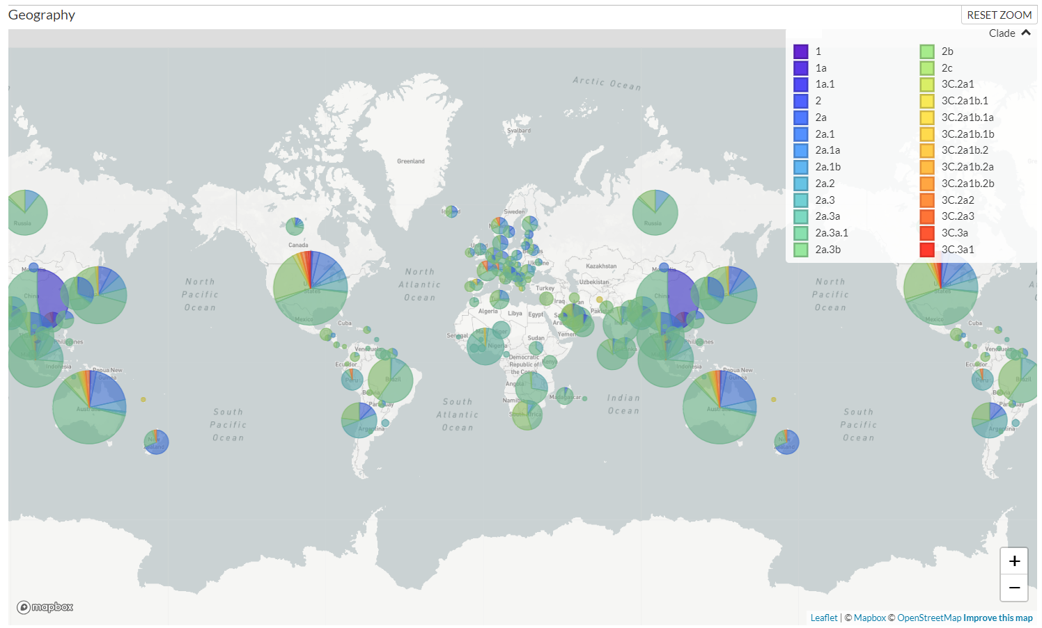

Slide 23
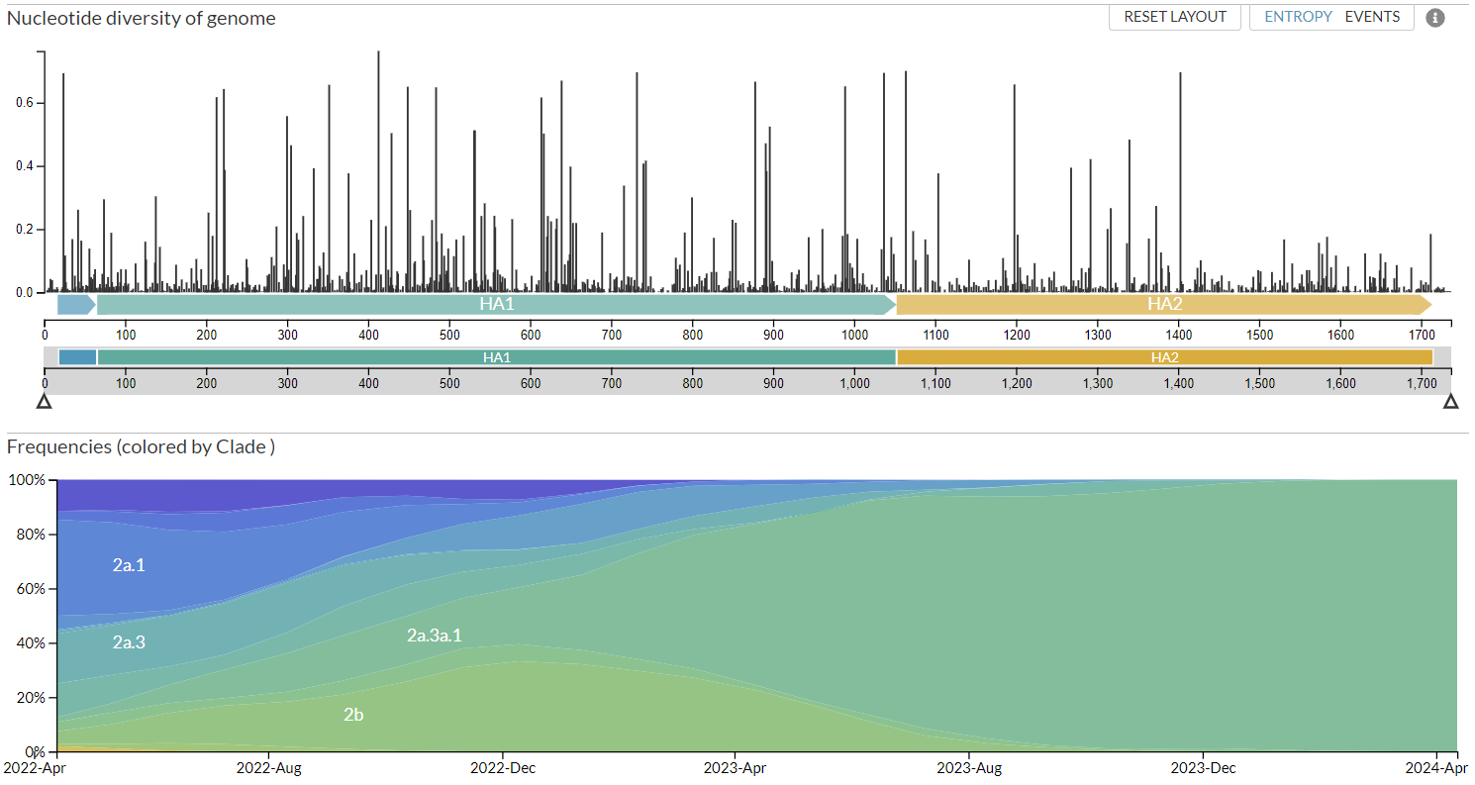

Slide 24
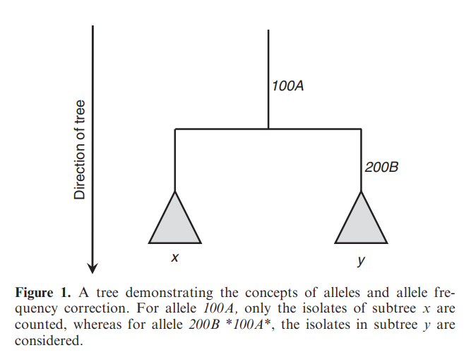
Overview
Allele dynamic plots infer a phylogenetic tree and ancestral character state to look for characters with a selective advantage
Steinbruck et al. 2011
https://doi.org/10.1093/nar/gkq909

Slide 25
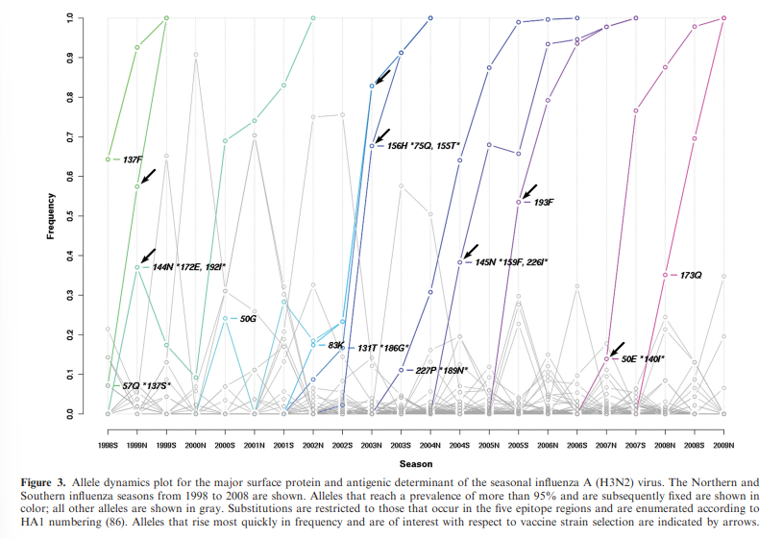

Slide 26
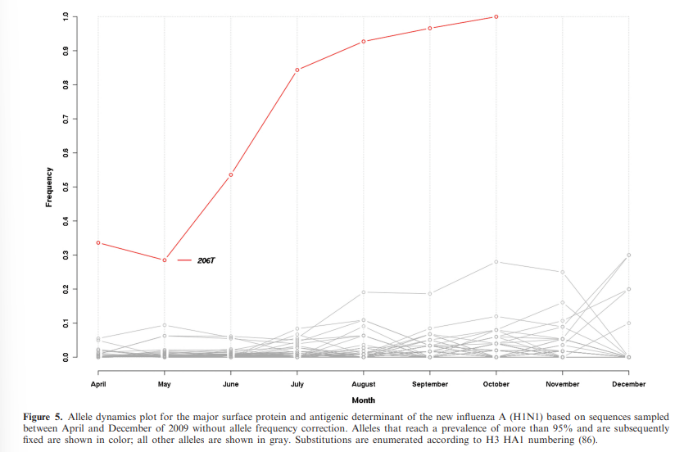

Slide 27
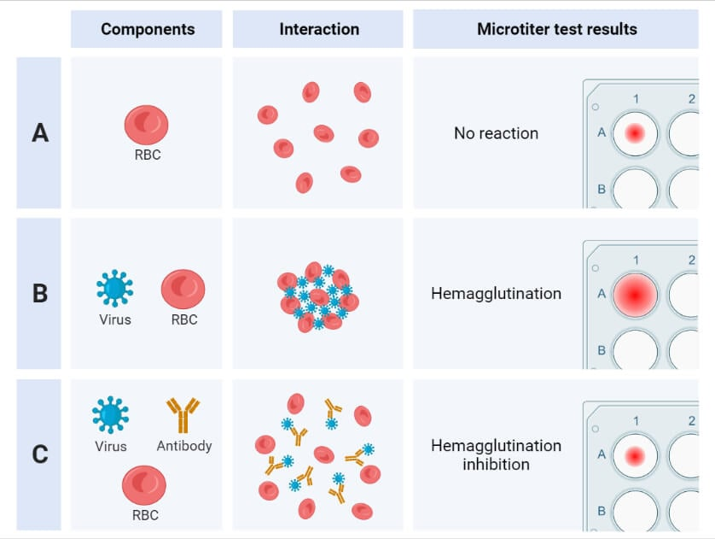
Overview
Antigenic maps represent serology data
These maps use hemagglutinin inhibition assays (antigens) and reference antisera (antibodies)

Slide 28
Overview
Antigenic maps represent serology data
These maps use hemagglutinin inhibition assays (antigens) and reference antisera (antibodies)
Ferrets (model system) have similar respiratory systems but different immune systems
Don’t factor in how a human’s immune history impact’s their reaction to new strains

Slide 29
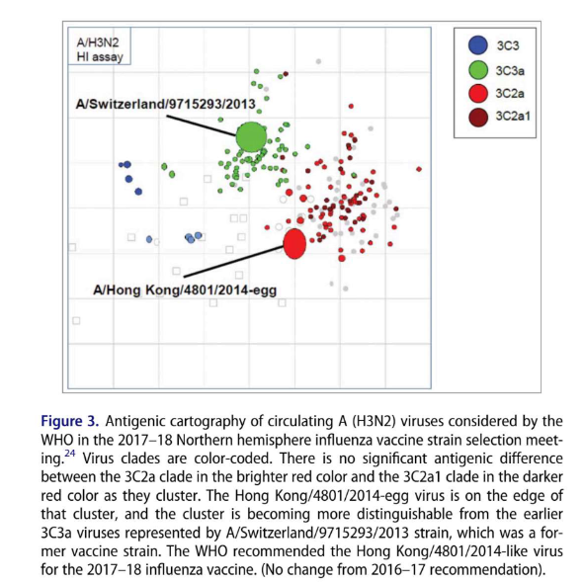

Slide 30
Findings
A variety of other computational frameworks, amino acid substation models , and fitness models are also future targeting methods
The combined use of these techniques is often needed for predicting the most effective strain to use for the vaccine
Annual vaccination rates also impact vaccine effectiveness

Slide 31
Questions / Discussion

